Slide 1
Data Visualisation using a Case Study on Subsidy Policy
Task: To present summary table intuitively to a non-technical audience
Tools: Tableau, Excel, PowerPoint

Slide 2
Colleague wishes to present insight, comparing career choices by recent graduates from a course of study
Problem statement
1 / 2
Colleague has been working with a dataset which contains salary information on recent graduates from a specific course of study, heavily subsidised by the government
Talking points to include have already been decided
However, colleague is struggling as the request from management is to
Put the following in one visualization,
While also reflecting the dataset’s characteristics
 |  | Student Group X |  | Student Group Y
Job Nature | Industry | Median | Count | Median | Count
Closely related to course of study | A | 3,150 | 83 | 3,000 | 23
 | B | 3,300 | 53 | 3,100 | 9
 | C | 2,650 | 47 | 2,600 | 32
 | D | 2,400 | 12 | 2,400 | 15
Somewhat related to course of study | E | 4,100 | 30 | 3,900 | 3
 | F | 3,400 | 23 | 3,150 | 7
 | G | 2,800 | 12 | 2,600 | 22
 | H | 2,300 | 8 | 2,200 | 11
Unrelated to course of study | Others | 2,900 | 21 | 1,900 | 28

Slide 3
Colleague wishes to present insight, comparing career choices by recent graduates from a course of study
Problem statement
2 / 2
Points to include
Key takeaway
There may be value to review subsidy policy for this course of study, because considerable proportion of students from each group do not go on to work in industries closely related to it
For Group X, this may be partially due to higher / comparable salaries offered by other industries. For Group Y, non-salary factors may play a more prominent role
Data characteristics
There are considerably more students from Group X than Group Y
More students in Group Y work in jobs unrelated to course of study, viz Group X
Distribution of students in various industries are considerably different between the two student groups
Students in Group X tend to be paid higher, holding job & industry constant, viz Group Y
Salary differential between Groups X and Y differ by job nature and industry

Slide 4
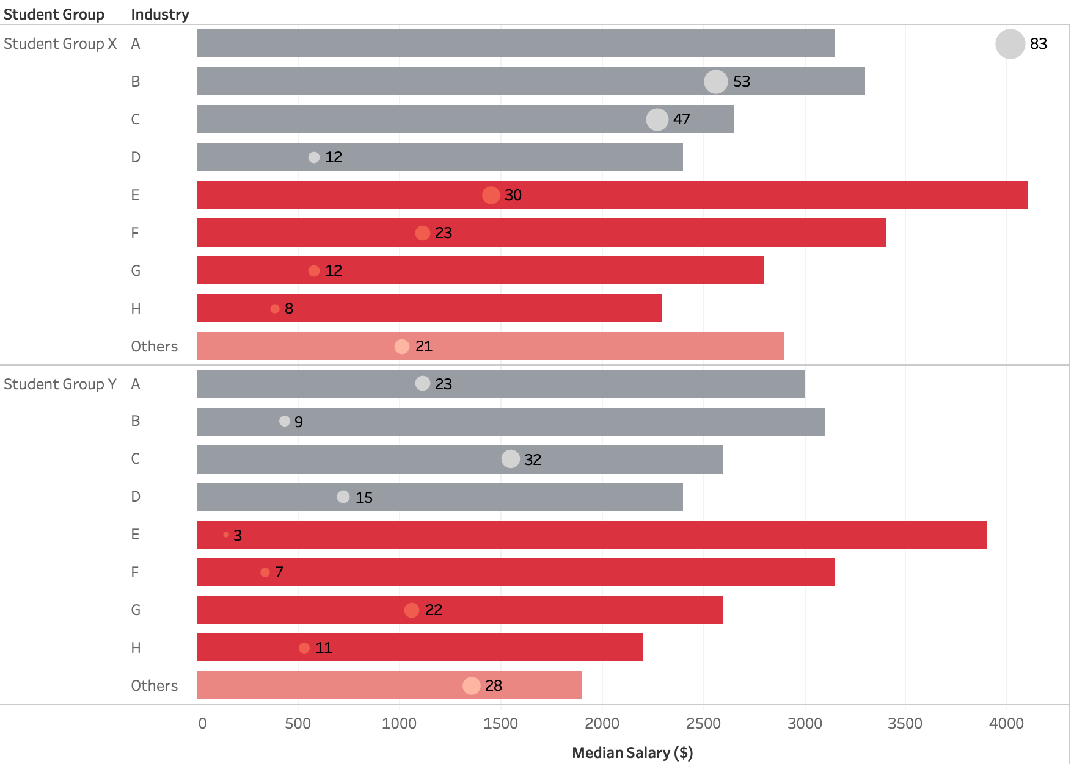

Subsidy policy for “course of study” (i.e. CoS) needs review, as a significant proportion of students do not work in the same industry upon graduation
One-slide view
Median Salary ($)
Closely related to CoS
Count
Somewhat related to CoS
For Group X, this may be driven by higher or comparable salaries offered by industries somewhat related / unrelated to CoS
Unrelated to CoS
Closely related to CoS
Somewhat related to CoS
For Group Y, other non-salary factors may play a more prominent role
Unrelated to CoS

Slide 5
While this was requested, believe that this is not the ideal visualisation
Comment on One-slide view
Resulting visualisation may tick all the right boxes, but it is very cluttered
Ideally, I would do it as per the following slide with
Two visualisations; one for each insight (per slide 2)
Use both views to bring also represent the data characteristics, without distracting from the data story

Slide 6
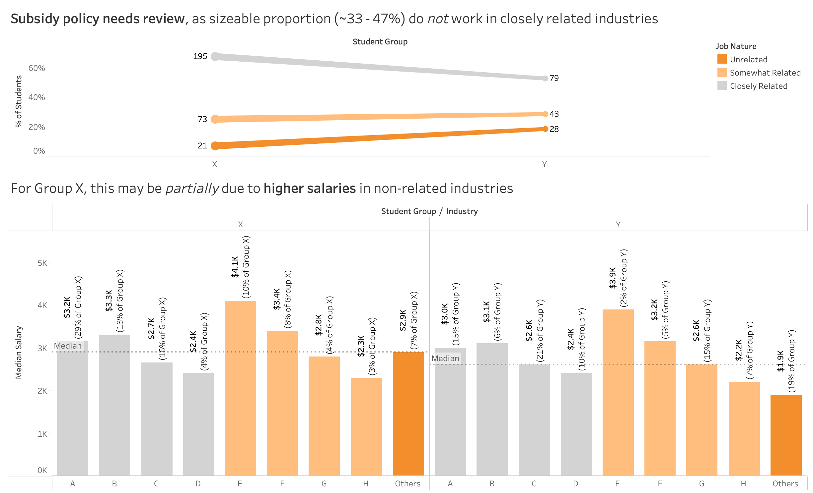
Proposed view

